Slide 1
Pain(t) UML Diagrams
Mason Tulacz

Slide 2
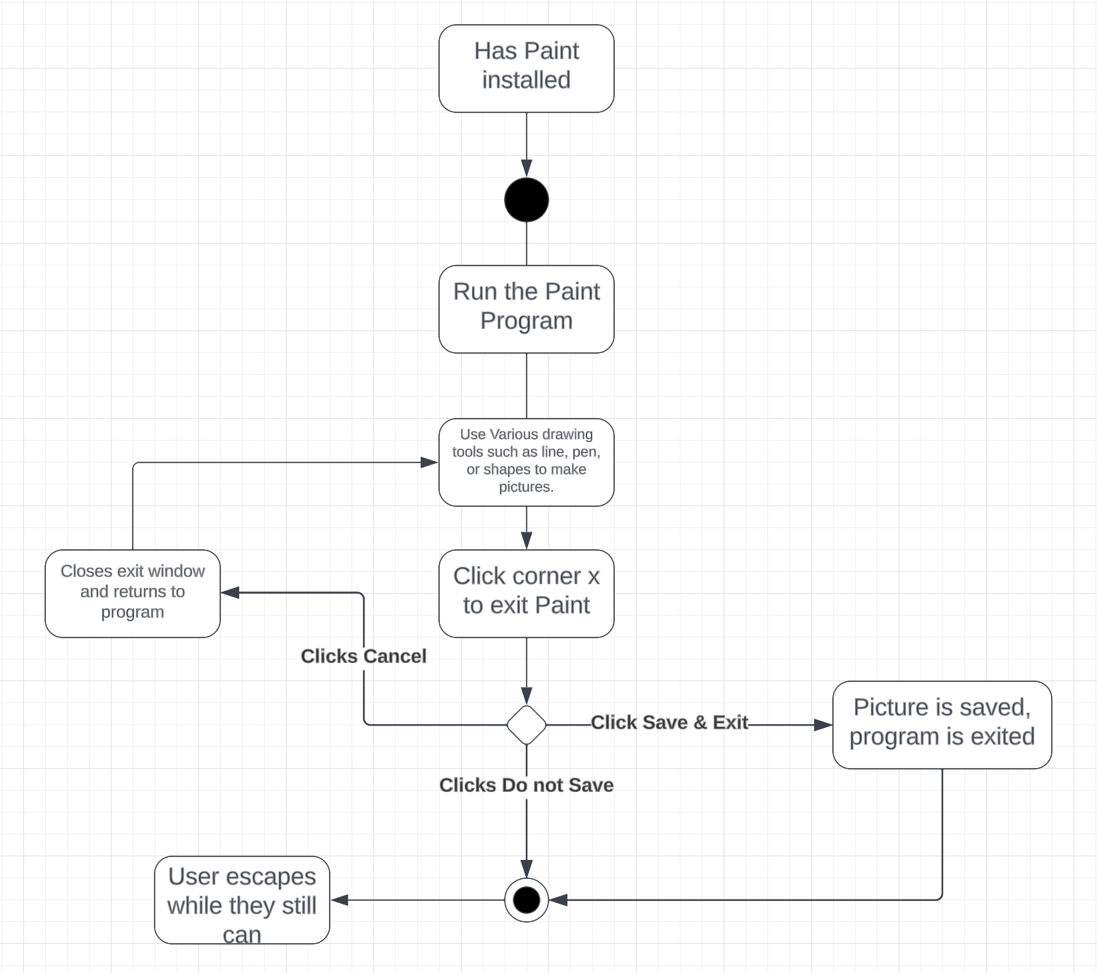
Activity Diagram

Slide 3
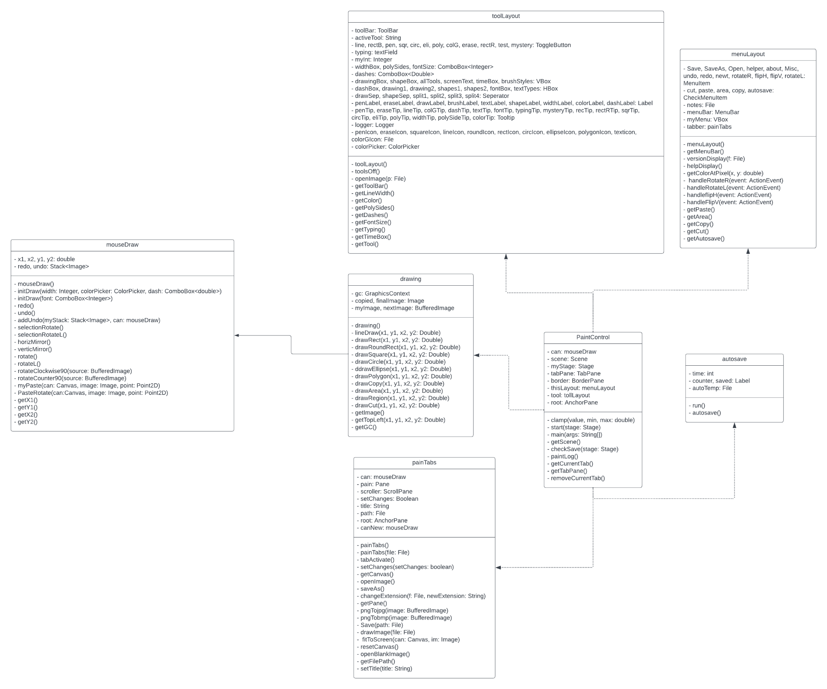
Class Diagram

Slide 4
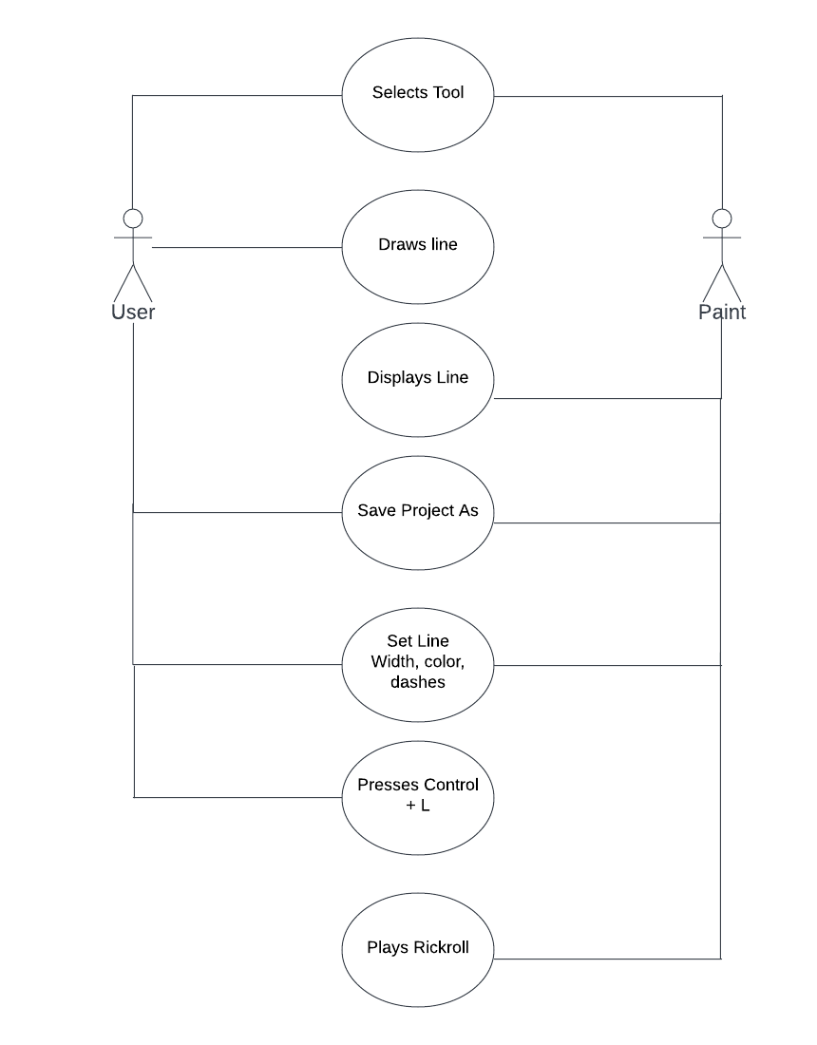
Use Case Diagram

Slide 5
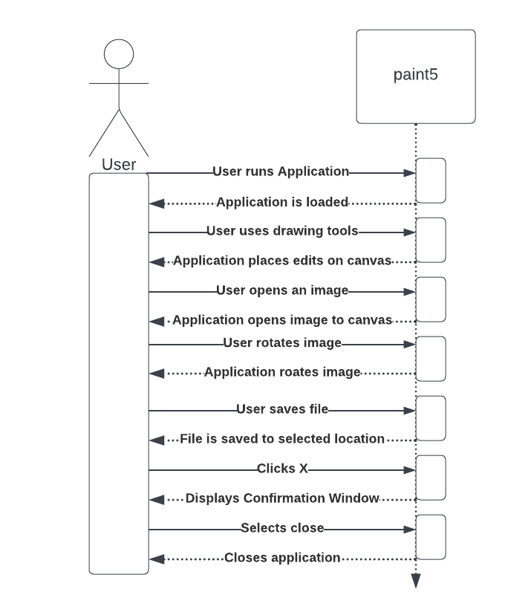
Sequence Diagram

